Slide 1
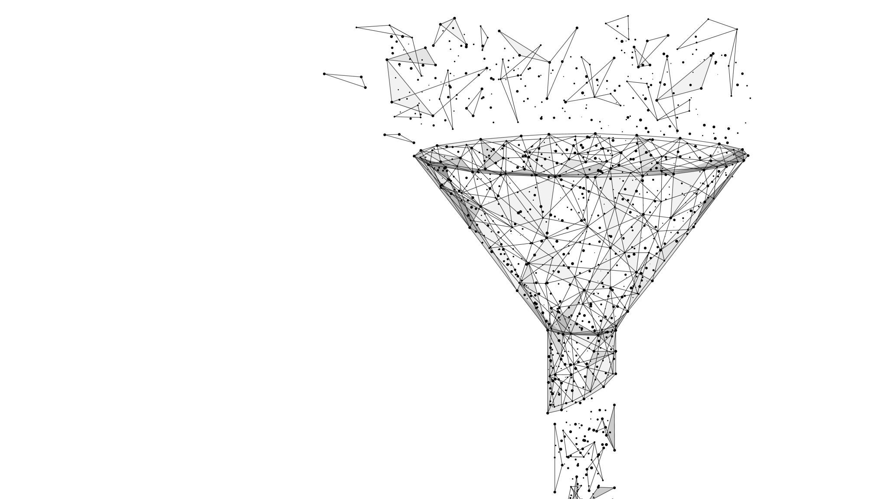
Digital Marketing Funnel
Anshu Sharma

Slide 2
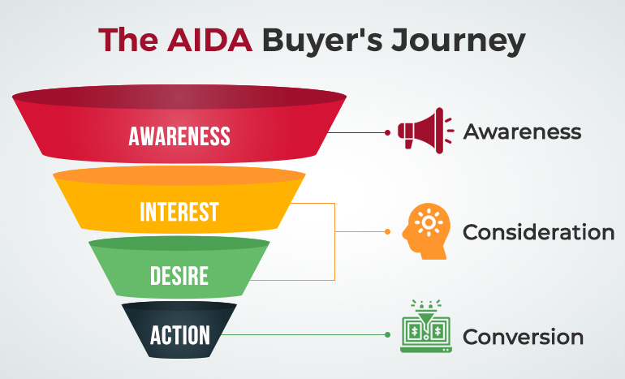
Market Potential
Suspects
Prospects
Customers

Slide 3
Attract
Engage
Capture
Nurture
Convert
Awareness
Educate
Interest
Consideration
Decision
Action

Slide 4
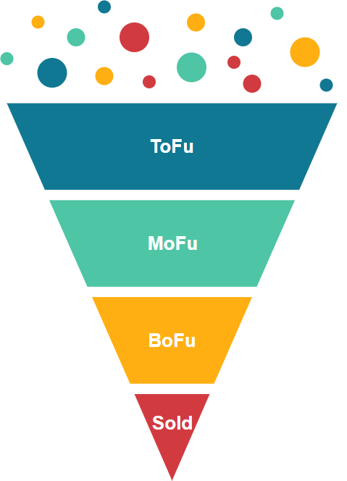
Awareness
Educate
SEO (Blogs), Content (YouTube), Social Media Marketing, Display, Lead Magnets
SEO MOFU targeted keywords, Email marketing, Video marketing, Newsletters, SEM, Free Trials
Interest
Consideration
Decision
Action
PPC Ads, Email offers, Offers on Social Media, SEO with BOFU keywords

Slide 5
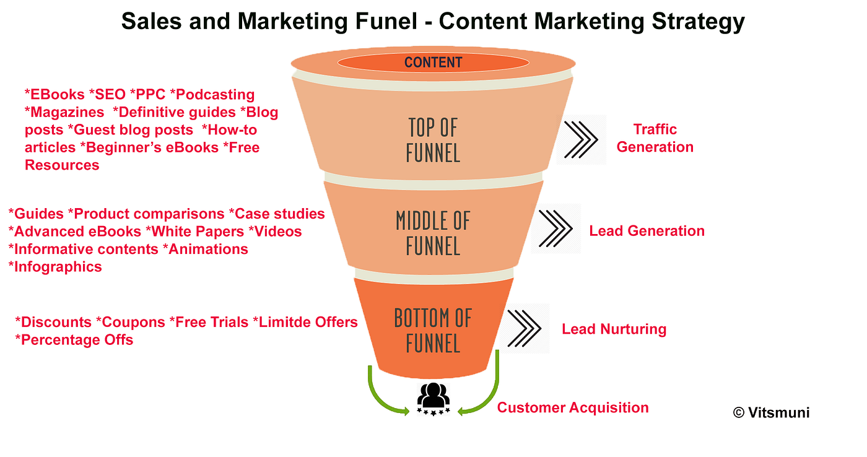

Slide 6
AIDAA​ | Platforms​ | Platform Type​ | Methods​
A​ | Display, YouTube, Facebook​ | Awareness platforms​ | Display​
I​ | Online PR, Rating, Testimonials, Celebrity, ROI, Payback, Pilot Testing, Comparison, Case Studies, Reviews, Economic Value​ | Intent platforms​ | Search, Cognitive Analysis, Comparison​
D​ |  | Credibility platforms​ | Influencer, Marketer, Celebrity Endorsements, Blogger, Online PR, Trials, Freemium plans​
A​ | E- Commerce, Marketplace, Aggregators, Portals​ | Transaction platforms​ | Promotion, Cashback​
A​ | Referrals, Recommendations, Review Websites​ | Advocacy platforms​ | Customer UGC, Testing Ratings, Reviews, Social Selling​

Slide 7
Content Marketing Funnel
Your Goal | Content | Your Audience's Goal
Attract | How-Tos Tips E-Books Social Updates Contests/PR Infographics Cold Emails Quizzes Podcasts | Learn
Engage | Benchmarking Reports Guides Free Tools Webinars Case Studies Testimonials Newsletters Explainer Videos Alternatives | Evaluate
Convert | Spec Sheets Pitch Decks Product Page Pricing Page Comparison Tools | Decide
Retain | Help Articles User Forums Surveys/Polls Performance Reports Product Updates New Product Announcement | Succeed

Slide 8
Example of a Funnel
Blog Post (SEO)
Email List
Nurture
Conversion
Customer A: reads the blog post, does not sign-up for email
Customer A sees a retargeting ad a week later
Customer A goes back to the blog
Customer A signs up for the email list
Customer A converts
Customer B: reads the blog post, signs-up for email
Customer B receives nurture (free) content
Customer B does not convert
Customer B sees another blogpost via organic search
Customer B converts

Slide 9
Key metrics to track in a funnel
Entry points
Conversion rates at each stage
Time in the funnel – TOFU, MOFU, BOFU
Exit Points
Content Engagement

